Slide 1


Sight Spectrum
www.sightspecturm.com
Corporate Overview

Slide 2





















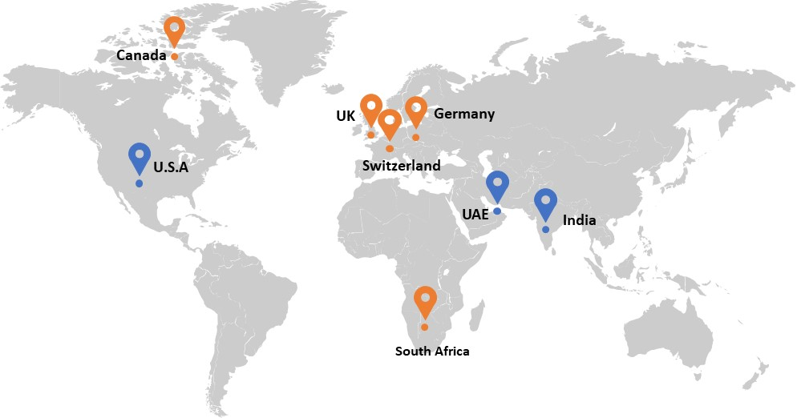





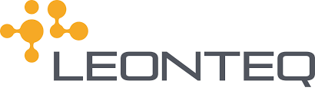

Corporate Overview
A digital revolution driven Technology Consulting and Services Company with an exclusive focus on Data, Cloud, Analytics, and AI
Transformation Offerings
Service Line
Technology Focus
Industry Domain
Enable Digital transformation through Data, Analytics and
Artificial Intelligence
Consulting & Delivery
Product Professional Services
Data
AI
Digital
Banking & Finance
Retail
Enable efficiency through Mobile & Web Applications
Products & Solutions
Comm. & Technology
Staffing Services
Boost Productivity through IoT, RPA, and Cognitive Services
Training Services
Analytics
Cloud
Big Data
Insurance
Healthcare
Key Customers
Locations
Accreditations
5+
Years in IT Services and Consulting
550+
Passionate Associates in
India and Other Countries
75+
Customers Across the Globe
300+
Completed milestones
36%
Workforce diversity

Slide 3

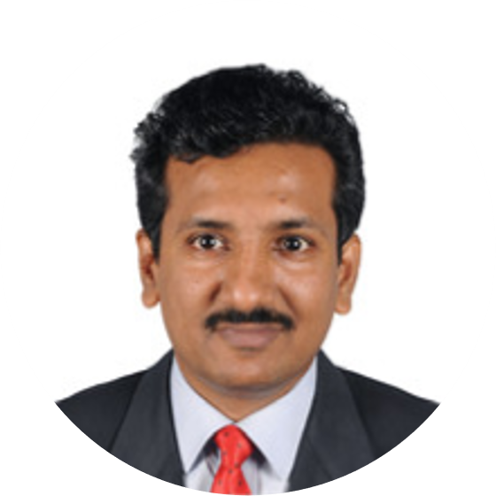
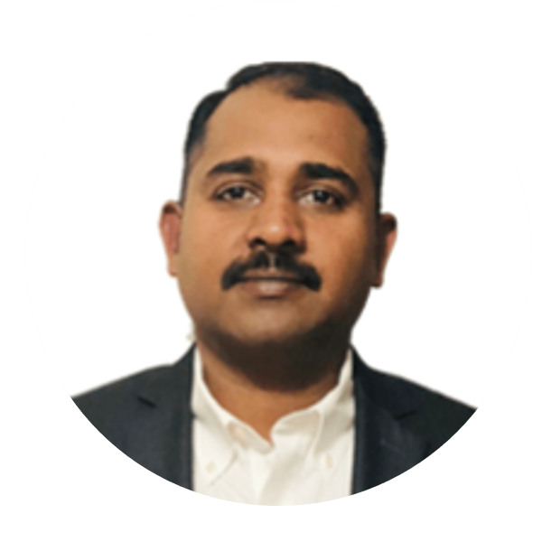
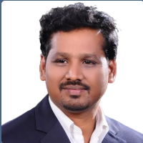
Our Founders
Held leadership positions in Tier 1 global IT services companies. Advised and delivered analytics solutions for 60+ Fortune 500 companies across the globe
19+ Years of Data and Analytics as Enterprise Data Architect and Delivery Director at Cognizant
Lead a 200+ global team to deliver data and analytics projects for customers in the US
Architected Analytics solutions involving various big data, data visualization, cloud, and automation technologies
Responsible for Analytics Project Delivery for Communication, Media, Information, and Technology companies
Senthil
28+ Years in Data Analytics as Thought Leader, Delivery Leader and Business Unit Head
15+ Years in Cognizant, Global Analytics Practice Head - Healthcare, Communication, Media and Entertainment (3000+ Team Size)
Trusted advisor 30+ Fortune 500 companies
Vinod
20+ Years of Data and Analytics as Enterprise Data Architect and Delivery Director at Cognizant
Managed a global team of over 300+ members
Rich experience in architecting and delivering analytics solutions for Communication, Media, and Entertainment companies in US, UK, and Netherland
Srivatsan
19+ years of global experience in data warehousing and ETL, specializing in designing and managing end-to-end DW&BI
Proficiency in traditional RDBMS, Big Data platforms, and cloud platforms, with expertise in database architecture (RDBMS, Redshift, Big Query, Hive).
Trusted advisor 30+ Fortune 50 Skilled in solution architecture for both traditional and Big Data environments, experienced in program management, and specialized in DW/BI solutions on the Hadoop platform.
Dhinesh

Slide 4
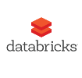
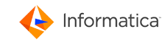

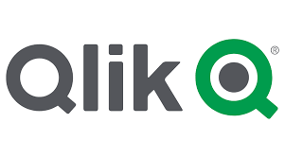



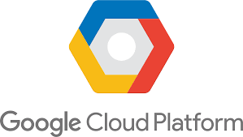
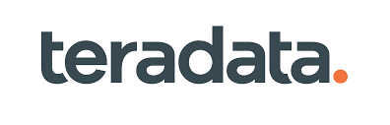


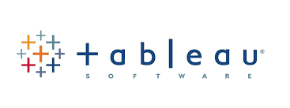


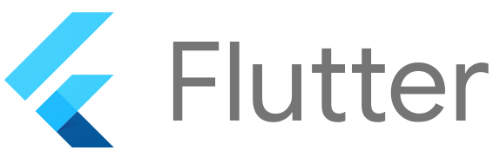















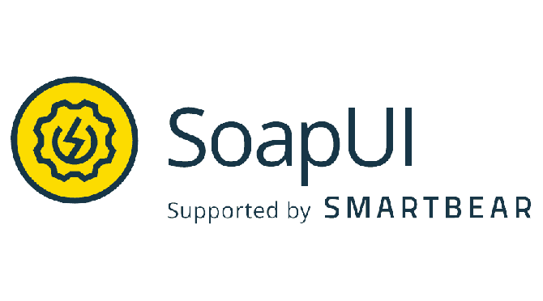
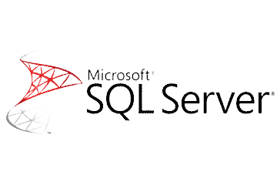


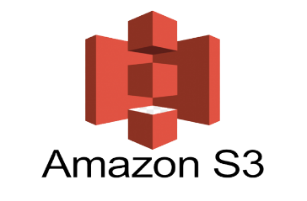


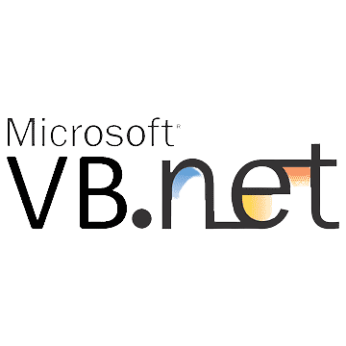
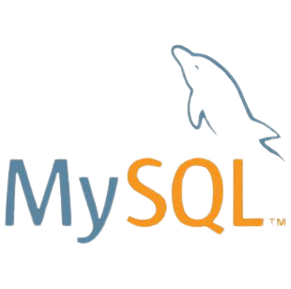
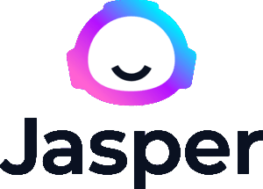




Our Competency Technology Landscape
- Key Focus Technologies
Notes:
Highlight six tech in first row
Open ai

Slide 5


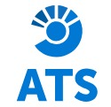


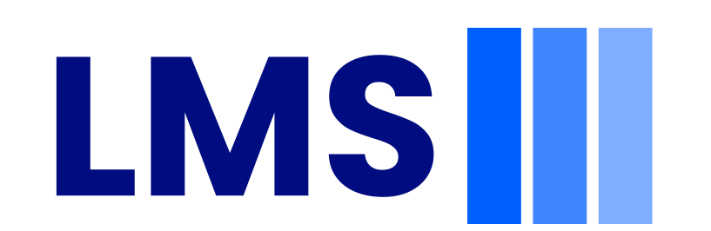



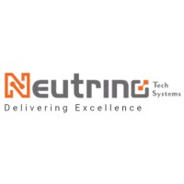
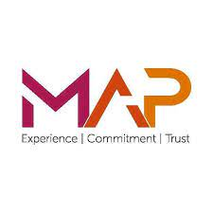
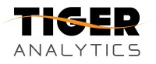




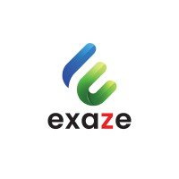


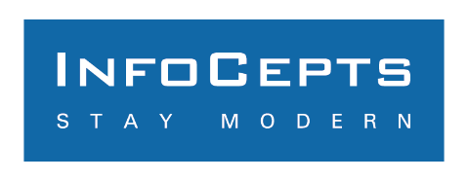






Partial Client List
Consulting & Delivery
Product Professional Services
Products & Solutions
Staffing Services
Training Factory
Partners

Slide 6
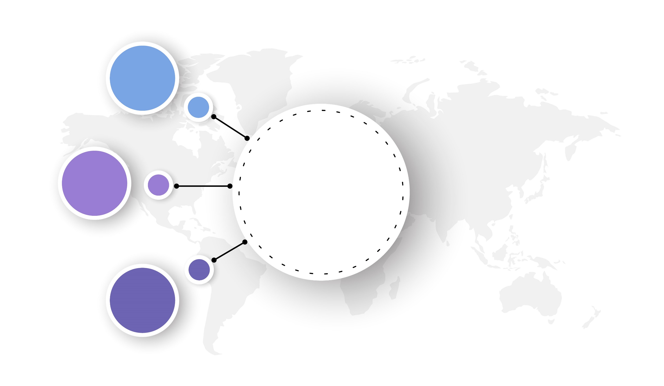







Service Spectrum
Data Modernization
Strategy & Consulting
Migrate DW / Data Lake to Cloud
Data Integration
Data Governance
Master Data Management
Data Quality
Data Security and Data Privacy
Data Migration
Data Virtualization
Strategy And Roadmap
Analytics Maturity Assessment
Cloud Migration Strategy
Business Adoption
Data Architecture
Technology Evaluation & Selection
Business Case & ROI
Industry KPI Libraries
Analytics and AI
Managed Support
Business Intelligence and Data Visualization
Predictive Analytics
Data Science
AI/Machine Learning/ Deep Learning
Cognitive Intelligence
Immersive Analytics
Product Development and Engineering
IOT and Blockchain
Corporate Performance Management
Intelligent Automation
Digital Operations
Shared Services
Global IT
Staffing Services
Staffing Services
Training
Permanent
Contract
RPO
InPlant
Hire-Train-Deploy

Slide 7






Analytics and AI > Qlik Competency
Analytics
Log Analyzer provide summary of data load and errors
REPCTL Automator for job deploying jobs between environment
Won Professional service deal with Qlik Replicate
Inhouse Lab for Qlik Replicate & Compose
Professional Service
Research Services
Architecture Services
Delivery and Execution Services
Training Services
10+
Clients
20+
Total
Practitioners
System Integrator Partnership
COMPETENCY
The fastest growing data synchronization and self-service visual analytics technology in Sightspectrum
50+
Projects
10+
Total
Practitioners
SERVICES PORTFOLIO
ALLIANCE
ACHIEVEMENTS
SOLUTION ACCELERATORS
Data Integration
Representative Experiences
QlikView & Qlik sense
6 highly flexible, multilingual dashboards with 200+ KPIs delivered for actionable insights across functions
10 Dashboards with 100+ KPIs developed with powerful visualizations to project Account and Sales data
Qlik Replicate & Compose
Working with 50 Qlik Replicate and compose Customer
Setting up environment and providing Architecture guidance

Slide 8
Informatica Competency
Informatica
Awarded Solution of the Year
Delivery and Execution Services
Infrastructure service
Research Services
Architecture Services
Training Services
20+
Total
Associates
System Integrator Partnership
In house validation rule prepared to validate the feature group data
10+
Clients
COMPETENCY
Connect data across the enterprise for a contextual 360-degree view and insights with intelligent master data management (MDM)
2+
Clients
10+
Total
Associates
SERVICES PORTFOLIO
ALLIANCE
ACHIEVEMENTS
SOLUTION ACCELERATORS
MDM &IICS
Representative Experiences
FCSA(Dubai Government)
Build Data mart using informatica (DQ&MDM) for PMO office

Slide 9

Data Modernisation > Microsoft/Azure Competency
On- Prem
Azure Cloud
Data Integration
Data Integration
ETL or ELT, SSIS,SQL, Real-time Deployment & Scheduling (Agent Control-M)
ETL or ELT, ADF V2, USQL, ADL & Blob,Azure DB & Azure WH
Data Modelling
Data Modelling
Conceptual, Logical and Physical data modeling (SQL), Data dictionary, DW,ODS, OLAP and DM design
Conceptual, Logical and physical data modeling(Azure SQL/Synapse), Data dictionary DW, ODS,OLAP and DM design
Microsoft Competency
BI & Analytics
BI & Analytics
SSRS, SSAS, Power –Bi & DAX & MDX
AAS, ADF, ADLA, Power-Bi & DAX & USQL
L1,L2 & L3 support
Azure Data Bricks
SSIS,SSRS, Control-M, SQL Agent & DBA
Synapse, BLOB, PolyBase** & ADW,AAS
50+
9
7
Trained Practitioners
Projects
Certified
Professionals

Slide 10




Data Modernisation > AWS Competency
Cloud Assessment Questionnaire
Cloud Data Migration Platform
CloudWatch – No Code Migration Solution
40+
6
7
Solutions / Platforms
Trained AWS Practitioners
Projects
Certified AWS
Professionals
AWS Consulting & Advisory Services driving Enterprise Digital Transformation
Application Transformation & Migration Services
Cloud Auditing and Security Services
AWS factory-based Delivery & Managed Services
AWS
Capabilities
AWS Offerings
2 AWS Architects
CEO Sponsorship
Continuous Trainings and enablement
End to end understanding of AWS Eco-System
Proven Expertise
Cloud Steps Enterprise Adoption framework
AWS Assessment Kit – Assessment framework for AWS suitability
Cloud Security Framework
AI Driven Data-First approach to achieve future-ready responsive data foundation
Accelerators / Toolkits
AWS Product Professional Services
Building a Product for a Partner in Sweden
AI Product to deduct security violations, vandalism in Software As a Service (SaaS) model using AWS, Terraform, Kalfa, .NetCore.
Representative Experiences
Pharma Customer in US
NLP based solution using AWS Stack
Extensive AWS components used along with Data Quality, Metadata lineage based framework

Slide 11

Talend Competency
Thought Leadership on Talend Technologies
About Talend Capabilities
Big Data Integration
Master Data Management
Metadata Manager
Talend Technologies
Cloud Integration
Data Integration
Delivery Excellence
Design, Build, Test & Deploy
Lineage, Metadata Management
Legacy
Modernisation
Data Lake
Data Quality, Reference Data
Migrations & Upgrades
Migrations and Upgrades
Talend Upgrades
Informatica, DataStage, Ab initio Migrations
Data Migration
Migration / Upgrade
Testing
Consulting
Strategy and Foundation
Architecture Definition
Infrastructure Sizing
Performance
Optimisation
Migration
Strategy
Data Lake
Maintenance Support
Continuous Integration and Deployment
DevOps
24x7 Support & Enhancements
Offshore, Near
Shore Support
Administration, Shared Services
Training, Labs
50+
9
7
Trained Practitioners
Projects
Certified
Professionals
Notes:
Change color theme

Slide 12








Products, Solutions & Accelerators
Data Integration Framework
Learning Management System
A Unified data system harmonizes multiple sources effectively
E-learning platform for delivering, managing, and tracking courses.
Qlik Replication Framework
AI Data Governance Platform
Monitor replicate server, deploy code, collect data, and send failure notifications to users
A Platform that drives transparent, explainable, and auditable artificial intelligence workflows
Process Migration Framework
Generative AI Framework
Cloud-driven data transformation framework to modernize application data
Enterprise-grade conversational AI for business automation, analytics, and integration
HC Insights
Conversational AI Platform
Healthcare data analysis for insights, improvements, and decision-making.
NLP-driven AI platform bridging the human-machine gap with machine learning.
Notes:
Process Migration Framework– Dataswitch
Generative AI – Cognius
Conversational AI – Conversight
ATS
Circulants MDM
One Slider for all of this

Slide 13






Workforce Solutions
Hire, Train & Deploy
Executive Search & Selection
Recruitment Process Outsourcing
We train the market candidates according to your needs.
This program includes training, hiring and deployment as per customer needs.
We find the best of the best to shape your organization
We own your recruitment functions to enable you to focus on your core business objectives
Contract Staffing
Technical Assessment
Payroll management & transfer services
Unmatched staffing experience
Fastest turnaround time,
Cost effective
Highly flexible and customized services
Our industry expert evaluators evaluate every candidate technically to provide you the best resources
Existing and new, we manage it all.

Slide 14
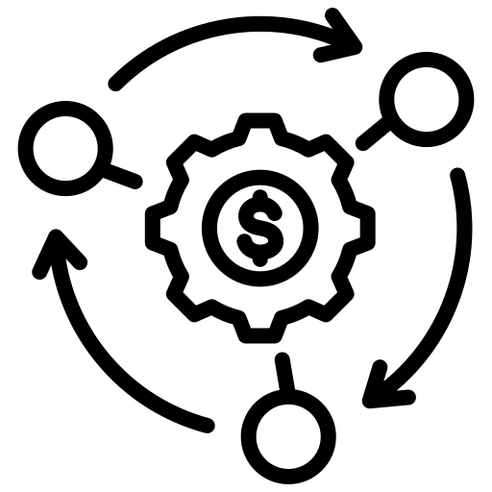



Talent Factory – Skill@Scale & Speed
Based on the business needs and objectives of our clients, we hire candidates, train them on specific skill sets and deploy them on live client’s projects
Hire Train Deploy
High Quality Trained Resources
Customer Benefits
Broaden trainee skill set, fostering adaptability and collaboration. Enhance employees' existing skills or acquiring new ones, ensuring they stay updated
Cost is 50% Lesser
Cross Skill / Upskill
One Year Training
Practice
Faster Delivery
OnDemand Skill
Provide organizations with immediate access to expertise and services without the need for long-term commitments.
Offers flexibility, scalability and cost efficiency
Support
To increase the success rate of our Hire-Train-Deploy model, we support both clients and candidates throughout the process and post deployment.
Experienced Trainers with
Assessments

Slide 15











Our Key Ongoing Services Engagements
Data & Analytics Support for 3rd Largest and 5th Largest Banks of South Africa using MSBI stack.
Migration and Application support of a mini Fixed Deposit, Loan, Mortgage Semi-Public Indian Organization
Data & Analytics Consulting Roadmaps for US Venture Capital Firm acquisitions.
Greenfield Data Warehouse for a US Hospital by extracting data from their cloud and On Prem environments using MSBI Stack.
US Data and Analytics transformation and support Project for a Life Sciences Customer.
High-end Consulting for Qlik Professional Services Team on Qlik Replicate, Qlik Compose and Qlik Sense.
Data & Analytics Development Project for UAE Prime Ministers Office using Informatica and Qlik.
Strategic build of a education platform for Ministry of Education UAE using Angular, Microservices, Dockers.
Legacy to cloud Migration of a SAP, Microsoft solution to Talend, Snowflake for a Canada Customer.
AI Product to deduct security violations, vandalism in Software As a Service (SaaS) model using AWS, Terraform, Kalfa, .NetCore.
Waste Management & QYRUS for a Leading modern application development company using web technologies.
Develop forecasting, Demand Planning and Recommended Purchase order algorithms for a Leading AI-powered augmented analytics company.
Data orchestration, developing ETL pipelines & data manipulation for a tech-enabled BPM services provider
Detax, Corp admin & Super admin created for a leading tech firm that powers micro-transactions and virtual economies.

Slide 16







Key Differentiators
Excellent delivery leaders and partner eco system for on time & high quality delivery
Depth of experience in solving customer problems with technology solutions
06
01
05
Breadth of experience across industry, bringing the best-of-breed solutions
In-house Center of Excellence. Trained and Certified Talents
02
04
03
Innovative Digital Solutions
Cost effective Delivery Models

Slide 17
Case Studies

Slide 18



Qlik Replicate(DB2i Series to Databricks/ADLS Gen2)
Business Scenario/ Use case
Customers want to replicate data between DB2 i Series environment to Databricks / ADLS Gen2
Real-time data
Zero Impact on source database/application
More than 20GB of changes every day. In peak hours around 5 GB of data gets in.
DDL changes have to be applied to the target
01
02
03
Proposed Solution
Outcome
Conclusion
Qlik Replicate to be used for near real time replication
Zero Impact since it reads data from Redo logs.
Data is getting replicated with less than 5 seconds of Latency.
Minimal maintenance cost.
$400K-500k cost saving
No extra resources were required

Slide 19
Leading Trade Association supporting World Airlines
Business Drivers
To address unique requirements of each Application and migrate historical data to Snowflake from SQL.
Re-engineer ETL Jobs in Talend to load incremental data from diverse sources
PowerBI Reports and Dashboards effectively replicating all the existing SAP BO Features.
Business Scenario
Customer has several legacy Applications cutting across different business domains like Air Traffic, Employee and Operational Statistics, Accounts, Clearings etc. These legacy applications use SAP BODS to extract and ingest data into SQL Server DB and provide SAP BO Reports. Customer is interested in cutting License costs involving SAP and move towards Organization aligned Unified Architecture with Talend DI as ETL, Snowflake for storage and PowerBI reporting.
Customer Objective
Solution Highlights
Generic and re-usable code component in Talend to migrate history data from SQL Server to Snowflake and audit record counts post migration.
Highly performant data migration component that utilizes bulk load components in Talend for Snowflake
Common Framework components in Talend for Encryption, Decryption of Service Account Credentials, Logging -Talend Logs, Talend Stats and Business, Technical support mail notifications.
Improved Data Quality through additional Data checks before loading to Distribution Layer
Snowflake Versioning and Deployment control through Scripts in Liquidbase
Detailed Design Documentation with Source-Target Mapping and Operation Manuals
Development, Versioning, Deployment Standards and Best Practices defined for Talend, PowerBI
Talend Platform Administration including License management, Patch Upgrades (process definition), Security Controls, Access Setup etc.
Talend DI v7.3.1, TMC (AWS), Snowflake, PowerBI
5
Applications to be migrated
1
Successfully migrated and in Production
500*
Entities to be migrated to Snowflake
>200*
Business Outcomes
Talend Jobs
Reduced Operational Expense
Re-engineered and Optimized Code Units
Value added innovations resulting in productivity improvements
>20*
PowerBI Reports
* Across all Applications

Slide 20
Leading Provider of Commercial Services to the Life Sciences Industry
Business Scenario
A leading provider of commercial services to the life science industry. The company offers a fully integrated platform of solutions to address pricing, access, reimbursement, adherence and product delivery challenges on behalf of pharmaceutical organizations. In 2019, the client acquired another firm to add Health Economics and Outcomes Research (HEOR) services to its platform.
Business Drivers
200+ ETL jobs in Talend (70% full loads), 100% Long running T-SQL Store procedures
Multiple BI Technologies. No Self-service BI environment. No report rationalization
Performance issues in data reporting
No Data Warehouse / Data Lake. 80% business rules in Store procurements
Severe Data Quality issues. No enterprise BI/DW architect
No Process adherence/SLA for resolutions and ticket management
Customer Objective
Solution Highlights
End-End lineage for all data reporting objects. Created Data models/ER and data flow documents.
Report rationalization. BI Technology rationalization. Create Self-Service BI platform for users to build reports independently
Performance tuning of long-running queries and fixing
Migrate BI data to DW/ Datamart
Implement data standardization and Data quality solution
200+
ETL Jobs
300%
Business Outcomes
Reduction in TTR
Faster turn-around on tickets
Minimized tickets by Self-Service BI Capabilities
More time spent on Billable work (On-boarding and supporting enhancements)
Improved confidence on data quality
Improved report rendering time; improved performance
300K
Annual Saving

Slide 21
An American Telecom Company
Business Scenario
A merger and acquisition had led to a great opportunity for the customer to consolidate the data, technology environments and also unify the business processes and applications. We were involved in Consulting, Solutioning impact analysis and development of various merger components.
Business Drivers
50+ Applications to be migrated
To Assess if components are required or not before migrating
To check if components exist or not before migrating
Lack of SME to make faster decision
Bringing many teams together before decisions can be made
Solution Highlights
Performed analysis to get the inventory of components to be migrated
Detailed reviews with business and IT to finalize components to be migrated
Detailed Impact Analysis of each component and proper decisioning on components to be sun-set
Used the existing framework of the target environment to ensure usability and standardization of environment
Informatica, Talend, Teradata BTEQ, Unix components where developed.
2000
Mappings Analyzed
$450K
Business Outcomes
Savings
Sunsetting of components resulted in license savings of $450K USD.
Newer requirements could be meet.
Improvised business decisioning due to on time information and faster changes to components.
Rationalization of the Teradata environments.
5 TB
Data Consolidation

Slide 22
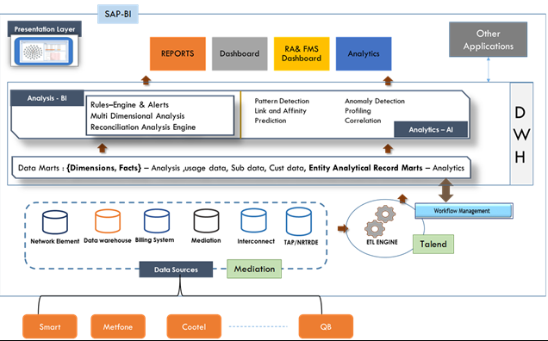



Communications Government Customer
Challenges
Mapping of 200+ source feeds from different telecom operators
Lack of an existing robust DW system because of which customer was not sure about the requirements
Huge data volume leading to performance issues in jobs (Long running jobs)
Frequent changes in the source feeds coming in from the telecom operators
Solution
Data mapping Creation of generic Talend ETL jobs, joblets to perform the data load into Landing/Staging/Fact tables
for 200+ source feeds
Creation of operational data tables that will be used by reporting team
Customer – DMC Report Mediation
Benefits
DMC is a department with in Ministry of Posts and Telecommunications in Cambodia. DMC’s responsibilities are collection of technical data and information from telecommunication and Internet Operators, processing the collected data, maintaining of technical platform and generating trusted and reliable governance reports for MPTC and MEF. Primary focus of the DMC project is to cover all the Mobile service providers, fixed-line service providers, Interconnect Service providers, VoIP service provider, Optical cable network service providers, Submarine cable network service providers and Internet service providers operating in Cambodian telco market.
360-degree view of telecom service provider’s service revenue and traffic. Including reporting and assurance.
International gateway traffic IP Data analytics.
Penetration of broadband and mobile telephony services
Monitoring the quality of service provided by telecom service providers.
• Provide better insights for improved decision-making.

Slide 23
A Government Entity in UAE
Business Scenario
This Project aims at connecting the client with all government entities to exchange data for statistical use to support UAE Vision to achieve National Agenda and support UAE competitiveness in international competitiveness reports by providing recent and high-quality data. We won a deliver excellence award already for the execution of this program.
Business Drivers
Irregularity in providing data
Disparities in technical capacity and mechanisms for data collection
Lack of SME to make faster decision
Bringing many teams together before decisions can be made
Multiple layers between Source and end users
Solution Highlights
Performed detailed Analysis of data by doing profiling and relative column analysis to identify the data quality issues
Leveraged Web services (push/pull) for data exchange
Leveraged Informatica Human Task for Data Steward purpose.
Created data quality reusable reference tables, data quality mapplets/rules to ensure usability and standardization of data
Leveraged Informatica and Oracle Exadata for building the solution
20+
UAE Ministries Data Consolidation
2 TB
Business Outcomes
Data
Reduce Manual effort required to exchange and cleansing the data
Timely availability of data
Uniformity and Accuracy of information
Merging data from different entities to get enrich the data
Central Statistical Data Exchange
200+
High Profile User Community

Slide 24
Large Bank in USA
Business Scenario
The customer is an international specialist banking and asset management group.
They are a full services banking firm with range of financial products and services to a client base in Canada and US markets.
Business Drivers
Multiple manual and automated processes in Risk and Regulatory reporting
Isolated and disconnected data sets leading to questions on the accuracy of data reported
Multiple silo source data sets with legacy DW and marts making modeling difficult
Limited knowledge on legacy data warehouses and its lineage
Redundant data storage
Conversion of data from legacy DW to newly planned Axiom models were time consuming
Customer Objective
Solution Highlights
Unified RRDW (Risk and Regulatory data warehouse) rationalizing and consolidating data silos
Adoption of FSLDM modeling for subject areas and objects
Technology and Re-Architecture to include Podium, Informatica and Hadoop for advanced processing
Adoption of CI/CD to improve faster deployment of changes and/or new requirements
Easier and faster outbound interfaces to Axiom and Modeling teams’ sandbox
Reusable development, recon and lineage components and frameworks deployed
Common Datawarehouse across bank which avoids data redundancy
Wealth Management end to end implementation
200+
Objects and Jobs
1 TB
Data
Business Outcomes
5
Subject Areas
Reduction of cost and improving the over all experience (accuracy and confidence on the data)
Scalable model to adapt to changing business scenarios quickly

Slide 25
3rd Largest Bank in South Africa
Business Scenario
The customer is an international specialist banking and asset management group.
They provide a range of financial products and services to a client base in three principal markets: the UK and Europe, Southern Africa, and Asia-Pacific. They are dual listed on the London Stock Exchange and the Johannesburg Stock Exchange.
Business Drivers
Increasing number of Control M jobs (700+)
Issues on Data integration of files from the provider
Packages are stored as File System and there are different versions of packages
Accumulation of SSRS reports and random Ad hoc Report Subscription requests
Limited knowledge on legacy data warehouses and its lineage
Redundant data storage
SLA Breaches due to data integrity (Sharing data of one customer to another customer)
Customer Objective
Solution Highlights
Identifying a better scheduling tool which can save cost and perform better
Automation of Recon of data (which seems to be difficult)
Upgradation of packages and moving to SQL Server storage
Moving the reports to Power BI which is more interactive and enabling cubes to make to help users or customers build the reports reducing the Ad hoc requests
Identifying tools to understand the data lineage
Common Datawarehouse across bank which avoids data redundancy
Checks in place to avoid the bad sharing
700+
Jobs
2 TB
Data
Business Outcomes
13
Node Cluster
Reduction of cost and improving the over all experience
Ensuring the security of customer data

Slide 26
A Consumer Goods firm in the US
Business Scenario
Develop a Voice-based artificial intelligence solution to replace humans in drive-thru restaurant chains. Creating a custom Automated Speech Recognition (ASR) for food ordering will provide better conversational experiences with improved accuracy and efficiency, thus enable business to streamline the drive thru food ordering process with lower operational cost and improved customer satisfaction.
Business Drivers
High Cost - On average restaurant spends $50K annually towards the employee compensation
Reduced Efficiency - Revise existing business metrics being displayed and add or remove new metrics to better address business requirements
Low Up-Sell - Non-uniformity in cases of dealing promotions and up-sell opportunities result in lost business
Customer Objective
Solution Highlights
Develop a Voice-driven Artificial Intelligence solution using DialogFlow (AI development suit from Google) that can interact with the customers and take their orders
Customizable voice bots as per business requirements
Easy integration with many devices
Accelerated response time for queries
8
Franchisees
100%
Business Outcomes
Productivity Enhancement
Increased productivity and Less manual error
High up-selling with Improved customer experience
Increase productivity of Staff and Inventory Management
Promote New restaurants – Less investment in Staff
Shorter standby times
80K
Cost saving per franchisee per year

Slide 27
Patient 360 @ Healthcare firm in US
Business Scenario
A Federally qualified health center (QHC) having multiple clinics and pharmacies in different locations. Data is siloed for each location and do not have unified view.
They envision integrated view of their patients and analytical reports on integrated data for better business decisioning. Also have constraint on the budget and need for cost effective solution.
Business Drivers
To provide integrated, comprehensive, and unified data at the organization level integrating from disparate sources – EMR, Pharmacy, Dental, HR and Finance
To Build a comprehensive analytical system to cater to business needs
Customer Objective
Solution Highlights
Built an unified data hub platform using MSBI platform
Integrated, data from varied data sources (Flat Files, databases, API, Snowflake) using SSIS / Stored procedures / .Net scripts
Integrated Pharmacy data from eight different locations to get a unified view
Integrated EMR data from Snowflake environment into SQL server data hub
Leveraged Power BI for developing intuitive dashboard and data visualization
Enabled self service BI through Tabular model
5
Source systems
8
Pharmacies data instances
Business Outcomes
500 GB
Trusted and Unified data
Analytical dashboards facilitated easier business decisions
Data (Integrated from 2 sources)

Slide 28
Ministry of Education - UAE
Business Drivers
Address students’ specific challenges and potentially curtail the student journey and transition into successful careers. i.e. Limitation in course details, flexibility , elective choices, Internships, scholarships, Industry participation, encouraging entrepreneurship
Supporting students towards engagement in both educational and extra-curricular activities
General framework that integrates the issues and solutions of all students in UAE Higher Education Institutions (HEI).
Development and advancement of education sector for developing outstanding human resources and competencies.
conspicuously lacking
Business Scenario
The Ministry of Education (MoE), UAE is the competent body focusing its potential into the development and advancement of the education sector to meet the future needs of UAE for outstanding human resources and competencies in various fields. The MoE is responsible for drawing up the national educational policy and linking the latter to a set of educational goals, plans and programs in accordance with the general objectives of the country. UAE is considered as one of the most dynamic, tech-savvy nations in the world and the MoE is striving to facilitate state of the art opportunities for the students.
Solution Highlights
Access opportunities that facilitate better quality education through Credit transfer, Scholarship, Sponsorship details
Better collaboration between Academia and Industry via Publications, Training provided by HEIs and CXOs.
Improve employable skill through Internship and volunteering
Better decision making through Assessment tool and Labor Market information (LMI)
Empowering student’s entrepreneurial skills and ideas through Crowdfunding.
Angular 11, Micro services, SQL Server 2016, Docker, Kubernetes, Message broker – RabbitMQ, Keycloak
100+
UAE Higher Education Institutes
150K
Higher Education Students
Business Outcomes
500+
Better clarity for the Students on their higher education choices and subsequent employability
Common platform for all stakeholders in the education sectors – Students, HEIs, CXOs, Employers,…
Ensuring value based education by incorporating new trends, innovations to the system.
Ensuring responsible, productive future citizens who can contribute positively to society.
High Profile User Community
(CXOs, Employers,.)

Slide 29
Sweden based Redefining Video Surveillance organisation
Business Drivers
A Solution to apply machine learning on top of Live stream video to analyze, detect and alert potential security violations such as Intruders, Vandalism and Robbery
Standalone open-source Machine learning algorithms
Intended to be marketed as Security as a Service based on the Software As a Service (SaaS) model.
Business Scenario
Aigoeye is designed to provide a way to view, monitor and screen the content captured with your surveillance cameras. Aigoeye is AI and Deep Learning video analytics product that adds intelligence to video cameras by analyzing the video content, extracting metadata, sending out real-time alerts and providing intelligence to security personnel and other security systems. Aigoeye extracts only the valid motion in a scene, filtering out noise such as lighting changes, weather, trees, and animal movements.
Solution Highlights
Cloud-based AI security surveillance solution offered as Software as a service (SaaS).
This will automate the monitoring and alerting capabilities of camera/s present at one or multiple remote locations.
An AI and deep learning video analytics product that adds intelligence to security cameras by analyzing the video content, extracting metadata, sending out real-time alerts and providing intelligence to security personnel and other security systems to counter security violations conspicuously lacking.
Pay as per the usage option
Angular 11, Micro services, AWS, Kafka, Python, AWS, DynamoDB, Docker, Kubernetes
1000+
Surveillance Cameras
5+
Organizations
Business Outcomes
>90%
Avoid high number of unjustified alarms, Seamless Scalability Of Video Surveillance
Zero maintenance, Minimises Human Intervention
Industry independent solution with GDPR complaint, user friendly dashboard
Helps Increase Business Efficiency & Gain Market Share
Avoid unjustified alarms

Slide 30
Nop Commerce E-Commerce website from Exaze IT.
Business Drivers
Nop Commerce is the most popular ASP.NET Core shopping cart in the world based on Microsoft technologies
Standalone open-source Machine learning algorithms
More than 1,500+ integrations Plugins, themes, language packs.
250,000+ members Community worldwide.
Business Scenario
Exaze it works on Digital transformation is not just about disruption or introduction of new technologies in existing business processes. It’s about value, people, enhancement and the ability to quickly adapt when need arises by making intelligent use of technologies and data at hand.
nopCommerce has powerful integral functionality that covers 100% of business needs of eCommerce store owners. nopCommerce combines all the robust functionality for efficient B2C, B2B, B2B2C and D2C sales locally and globally.
Solution Highlights
Quickly launch and scale your online store with rich built-in functionality: integration with payment and shipment services; warehouse managing; marketing and SEO tools; and mobile-friendly stores.
Use multi-vendor and multi-store functionality (B2B and B2C). Get the maximum advantage of enterprise-grade performance. Easy integration and limitless customization opportunities..
A flexible system to fit your demands: GDPR; multi-currencies and multi-languages; regional taxes and laws support; management of multiple international stores; integration with local services and suppliers.
Secured Payment architecture.
.NET Core 3.0, Web API, .NET Framework 4.8, JavaScript, SQL Server
150+
Partners
12+
Years of experience
Business Outcomes
60000+
Meet all security requirements for all kinds of businesses
Great Support team and community is always here to help.
Absolutely free - No transaction fee. No monthly fees. No hidden fees.
Live shops

Slide 31
NCC – Construction Company’s Assignment and payroll System
Business Drivers
Address employees connect and their work management in a proper systematic process where the employee will have a track of all his/her work in organized structure.
Supporting employee towards engagement in both project details and payroll details.
General framework that integrates all employee benefits and project tracks.
All different region employees from different AD group are also connect into single system.
Business Scenario
Uppdragssystemet is a web application and is primarily designed for NCC Teknik's consultancy. Uppdrag means Assignment, basically a time reporting system. The users are creating internal assignment in Uppdragssystemet and are dividing their time to the different assignments in detail for each day. The total amount of hours is sent in an excel file to HRS for importing to HRM (SE payroll system). The system is used to track the NCC Internal consultants work hours spent on consultancy works assignments for internal clients and NCC Consultancies
Solution Highlights
Single system for all regions of employees
Easy to access and share project details with a proper details like project and estimation.
Improve employable skill through Biztalk integration.
ASP, Micro services, SQL Server 2015, Kubernetes.
3
Industrial, Construction and civil engineering, Development.
4
Operations in Sweden, Norway, Finland and Denmark.
Business Outcomes
Better clarity for the employees on their payroll, project works and subsequent employability
Common platform for all employees from different regions – Finland, Denmark, Norway and Sweden.
Ensuring transparency on the project details and payroll structures.
12500+
Employees in Nordic region

Slide 32

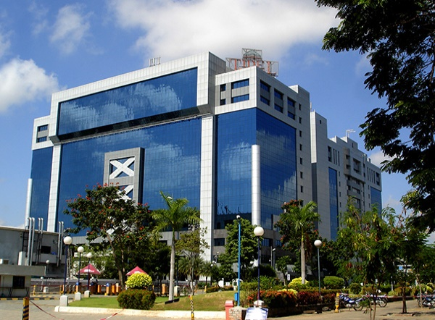
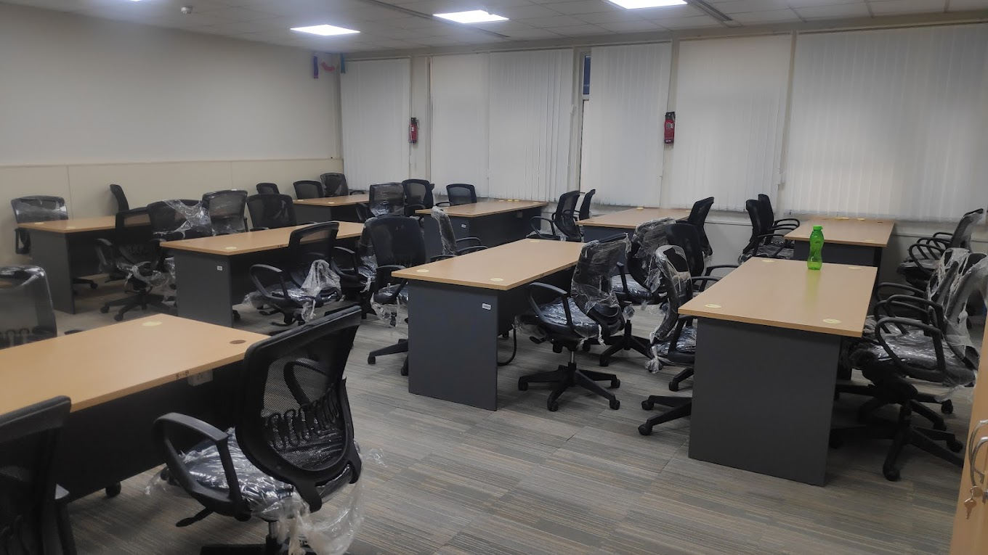
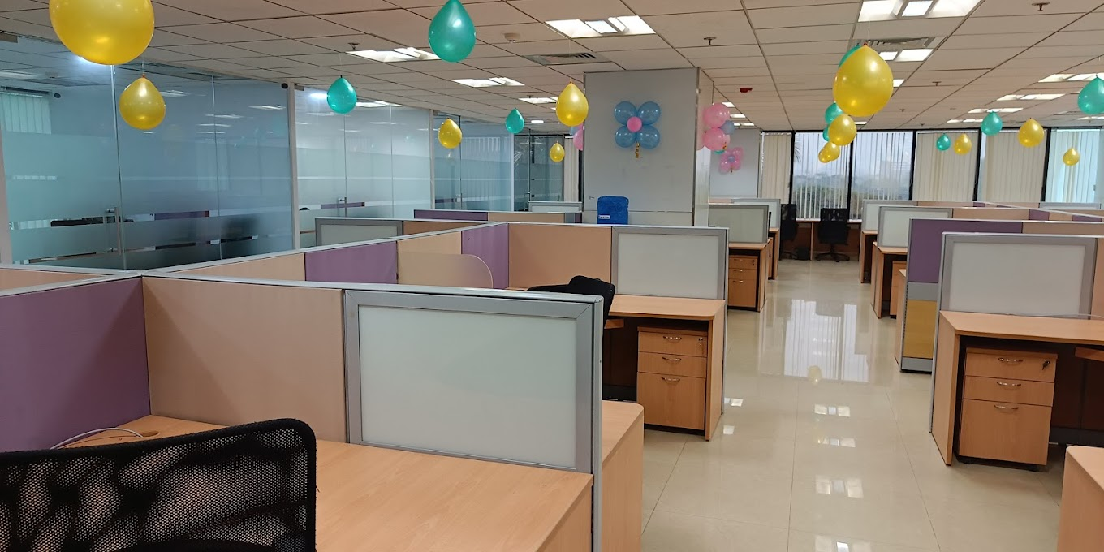
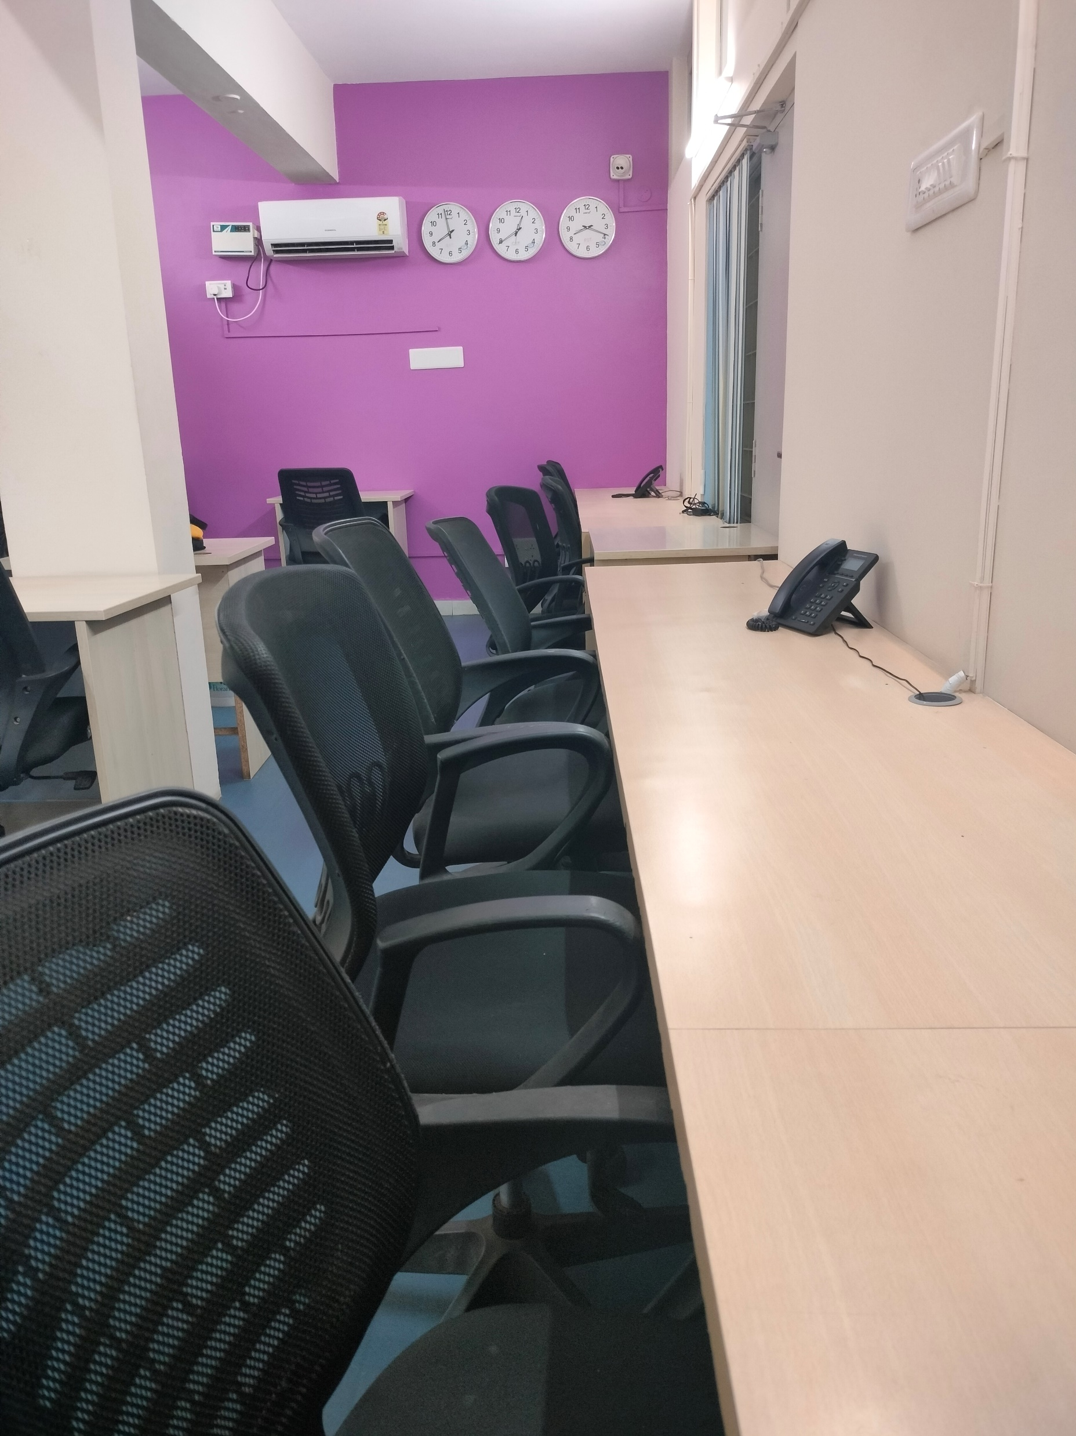
SightSpectrum Offices
Tidel
Mepz
Guindy
Thanjavur
Thanjavur
Physical Office Details
Tidel Park, Chennai, India
Module 107, Tidel Park, Taramani, Chennai 600113
Mepz, Chennai, India
Tambaram West, Tambaram, Chennai, Tamil Nadu 600047
Thanjavur, India
1520 South Rampart, JRS Complex, 2nd floor Thanjavur, 613001
RR 5 Tower, South Phase, Ambedkar Nagar, SIDCO Industrial Estate, Gandhi Nagar, Chennai, Tamil Nadu 600032
Guindy, Chennai, India

Slide 33


Thank You
SightSpectrum
info@sightspectrum.com www.sightspectrum.com
USA (Delaware, New Jersey)
UAE(Dubai)
India
33

